Slide 1
2.2 Methods of error detection
The need for error checking

Slide 2

The need for error checking
We send and receive vast amounts of data. One zebibyte is 1,180,591,620,717,411,303,424 (1.1 sextillion) bytes.

Slide 3
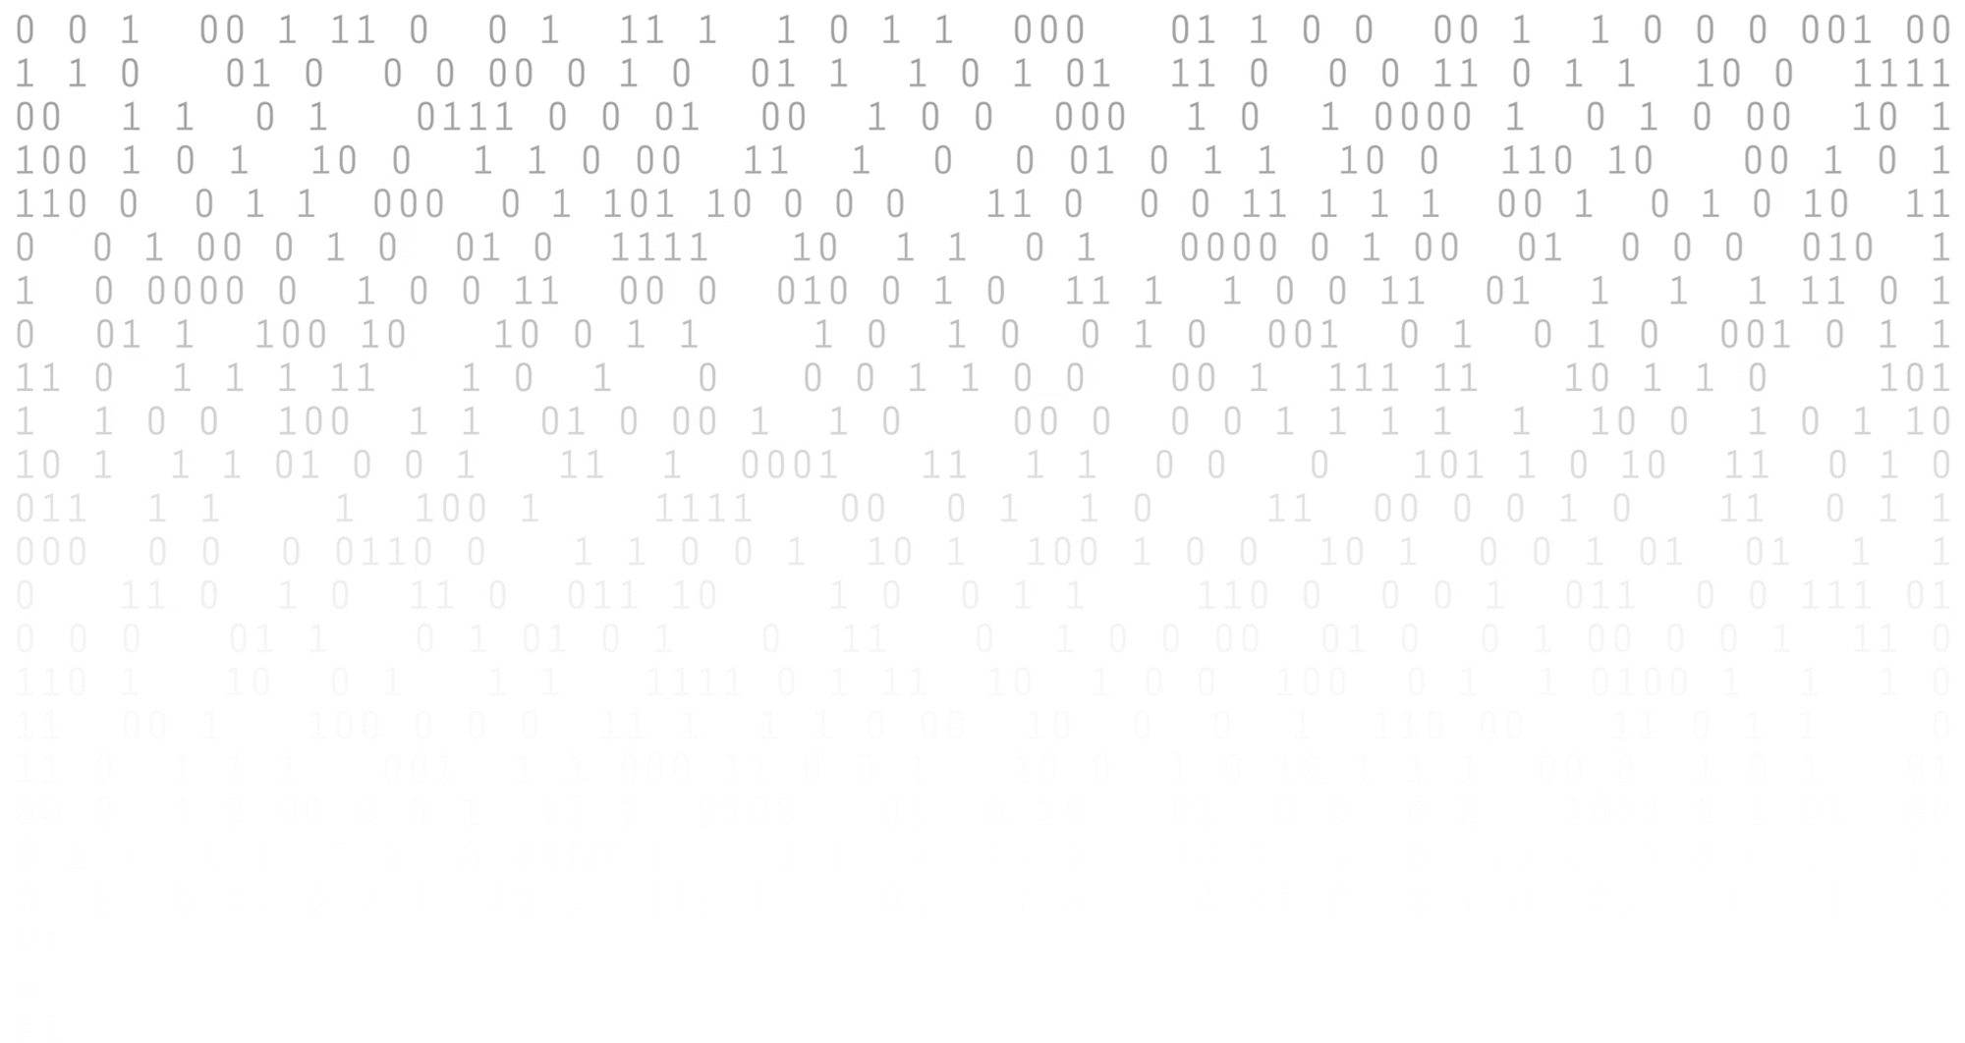
Title
The need for error checking
With the complexity of computers and the vast amounts of 1s and 0s being transmitted, there is always a possibility that data can be lost, gained or changed along the way.
text

Slide 4


The need for error checking
With the complexity of computers and the vast amounts of 1s and 0s being transmitted, there is always a possibility that data can be lost, gained or changed along the way.
text
Interference
Every type of cable can suffer from electrical interference, which can cause data to become lost or corrupt – i.e., 1s become 0s and 0s become 1s.
Packet switching
Issues during the packet switching process can cause data to be lost – or in some cases, gained.

Slide 5
Error checking methods
Error detection methods
Parity block checks
Echo checks
Automatic Repeat Query (ARQ)
Parity checks
Checksums
Check digits

Slide 6

The need for error checking
When data is transmitted, there is always a possibility that data can be lost, gained or changed.
The most common reasons for data corruption are:
Electrical interference (noise)
Problems during packet switching
Common methods of error checking include:
Parity checks
Checksums
Echo checks
Automatic Repeat Query (ARQ)

Slide 7


